Slide 1


PEMCO INSURANCE
BIM Retirement & Report Migration
May 2026
Bourntec Solutions | PEMCO Mutual Insurance

Slide 2
Previous State
Legacy BIM-Based Reporting Architecture
BIM as the Source of Truth
All enterprise reporting sourced from BIM (Business Intelligence Model)
BIM ran Daily, Weekly, and Monthly ETL jobs from HDS
Major monthly ETL on the 1st triggered SSIS packages & stored procedures
Data flowed into Production Reporting, PMIC Data Warehouse, and PMIC Data Mart
Reporting Tools in Use
BOXI (Business Objects): Scheduled reports via email & shared drives
SSRS: Proxy and operational reports
Tableau: Multiple disconnected dashboards, each with separate BIM sources
Agent Dashboard: Generated via SSRS from BIM stored procedures
Challenges Driving Migration
BIM retirement mandated migration of all reports to AWM/DWM (Enterprise Data Warehouse)
Table and column names differ between BIM and AWM — business logic must be re-implemented
Some reports pulled from multiple sources (BIM, Data Mart, Production Reporting)
Monthly BIM ETL dependency created latency and a single point of failure

Slide 3
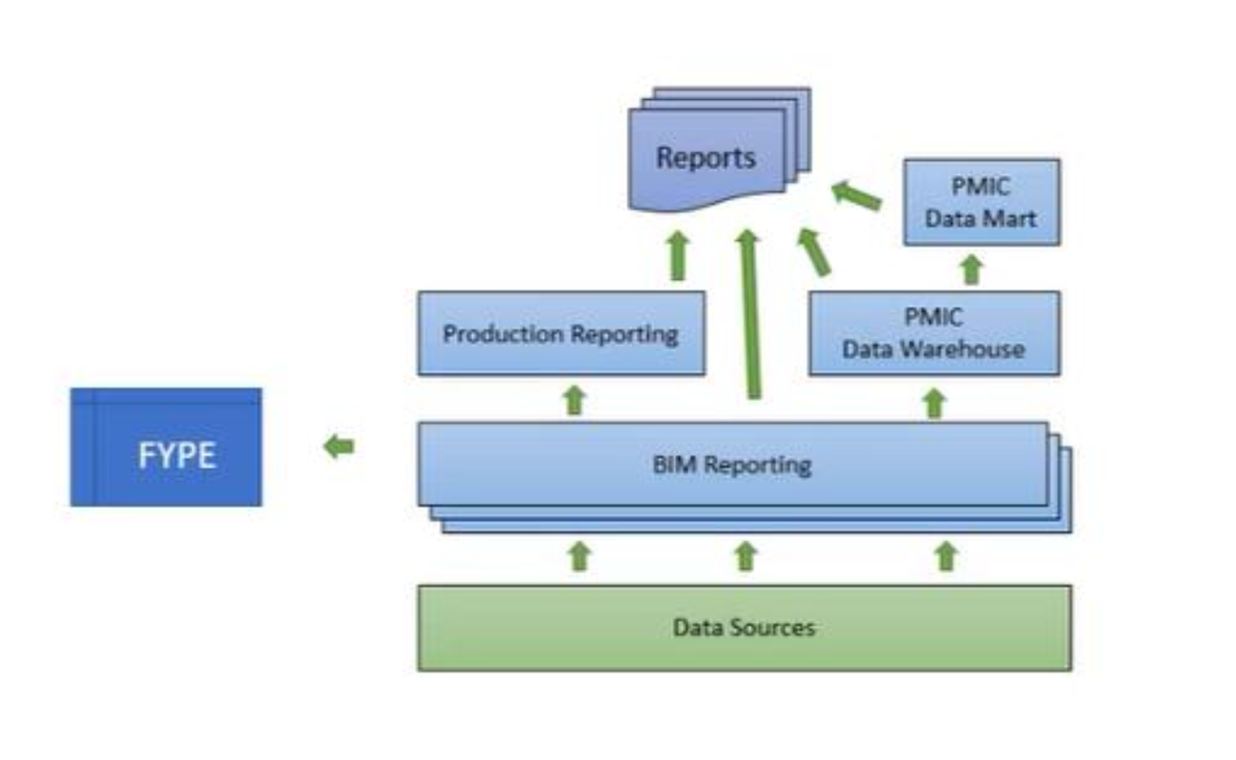
BIM Reporting Architecture
Previous State — Data Flow Overview
Key Points
• BIM served as the central hub — all data originated from BIM Monthly, Weekly, and Daily databases
• Data Sources (Exceed, HDS, external) fed BIM via SSIS ETL packages running on the 1st of each month
• BIM fed Production Reporting tables consumed by SSRS and BOXI for report generation
• PMIC Data Warehouse and PMIC Data Mart were downstream layers also sourced from BIM
• Final reports (BOXI, SSRS, Tableau) served from Production Reporting and PMIC Data Mart
• FYPE received a separate data feed from BIM outside the standard reporting path
• BIM-centric design created a single point of failure — any ETL issue delayed all reporting

Slide 4
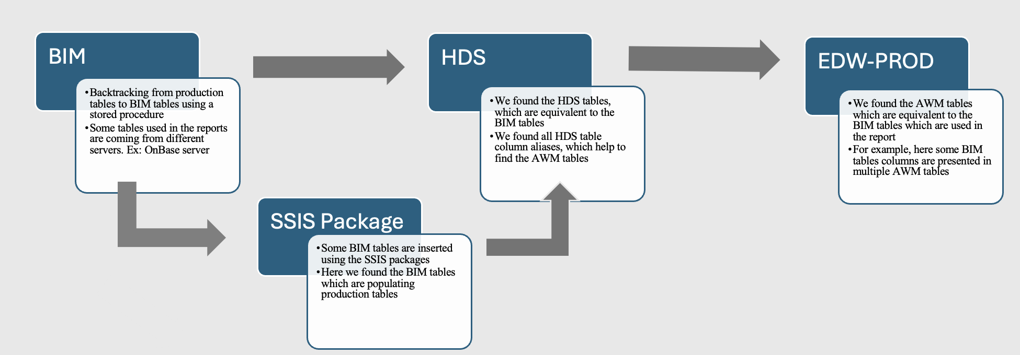
BIM to EDW-PROD Lineage Mapping
Migration Methodology — Tracing from BIM to AWM/DWM

Slide 5
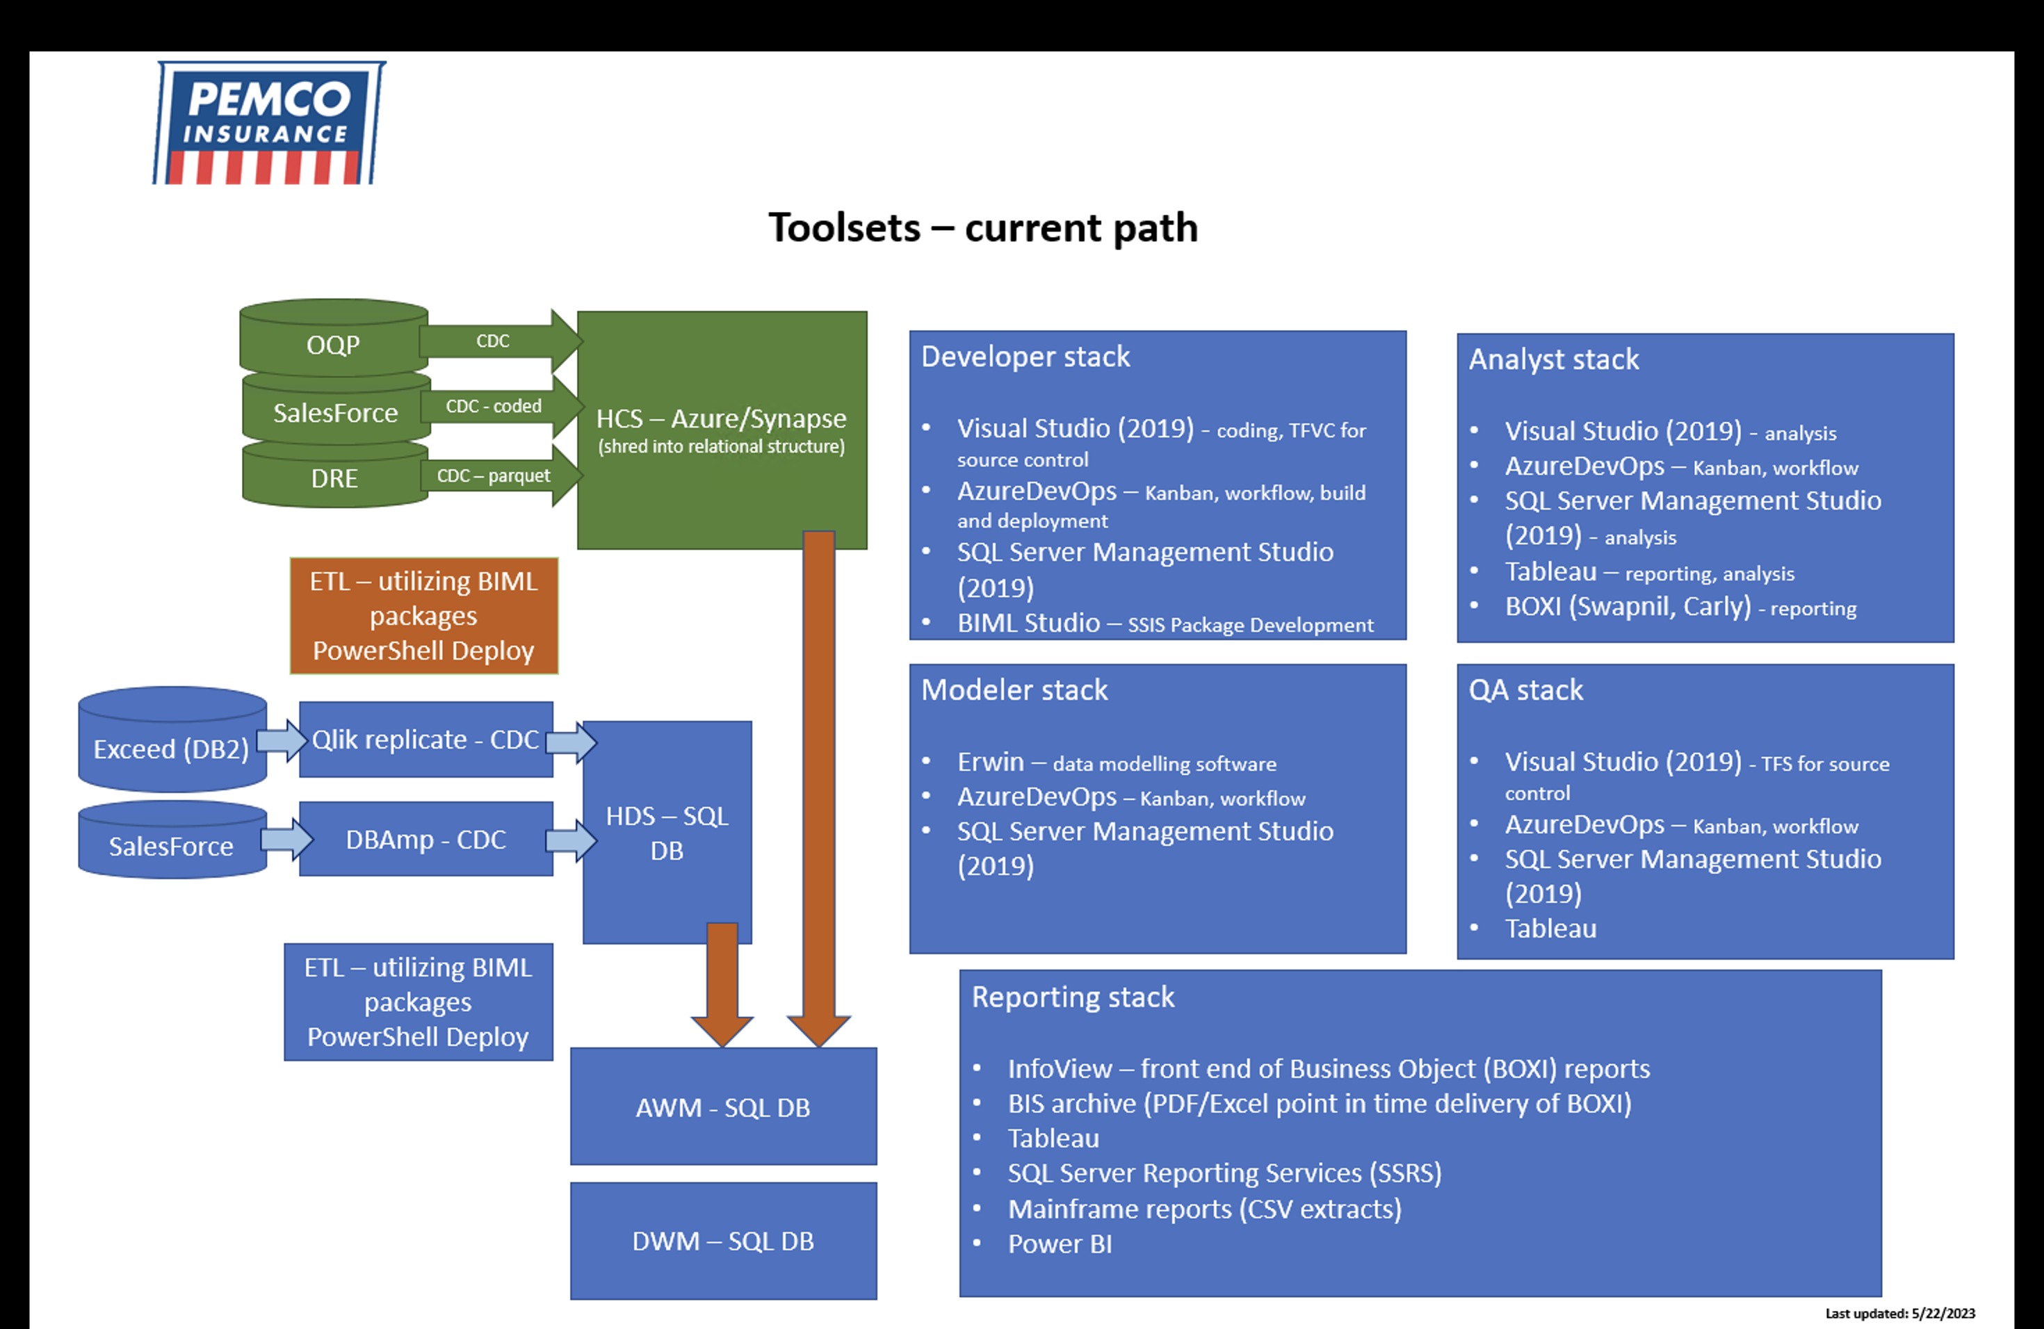
Toolsets — Current Path
Developer, Analyst, Modeler, QA & Reporting Stacks
Key Points
OQP, SalesForce, DRE → HCS (Azure/Synapse) via CDC
Exceed (DB2) & SalesForce → HDS SQL DB via Qlik Replicate / DBAmp
BIML packages + PowerShell Deploy for ETL at both HCS and HDS layers
Data lands in AWM SQL DB → DWM SQL DB (replaces BIM)
Role-based stacks: Developer (VS, BIML, AzureDevOps), Analyst (Tableau, BOXI), Modeler (Erwin), QA
Reporting: BOXI, Tableau, SSRS, Power BI, Mainframe CSV — all sourced from AWM/DWM

Slide 6
What We Accomplished
Completed Migrations — All Reports Status
BOXI → Power BI (Ellen's Requirement) | 4 Reports | Complete
BEFORE
Agent Loss Experience Report (O0140A-M1A-P01)
Agent Loss Experience Report — Current 12 Months
Billing Accounts with Suspended Disbursements (O0169A-W1C-P01)
Monthly Direct Sales Incentive Count Report (O0489A-M5P-P01)
AFTER
Power BI dashboards developed by splitting reports into page layouts:
• LOSS_DETAIL_PAGE_LAYOUT
• POLICY_COUNT_PAGE_LAYOUT
• POLICY_DETAIL_PAGE_LAYOUT
• PRODUCTION_STATEMENT_PAGE_LAYOUT
Developed Ellen's commission validation requirement - reports split into dedicated Power BI dashboards
Leveraged Existing PEMCO reporting tables edited & new tables created, replacing the BIM table dependency.
Logic was compared against BIM stored procedures and new stored procedures were built to support the Power BI data model
BOXI / SSRS → Tableau | 6 Reports | Complete
BEFORE
BOXI
Monthly Inforce Household & Policy Unit Counts
Monthly Manual Write Off
Monthly Write Off
SSRS
Monthly_Proxy_Emailed_Detail
Monthly_Proxy_Emailer_Dashboard
Monthly_Proxy_Received_Detail
AFTER
Each of the reports were developed in Tableau
Significant changes to the Logic were made using AWM/DWM tables, replaced the BIM tables
Logic was built based on stakeholder requirement for Monthly Proxy solicitations list
These reports are monthly run reports

Slide 7
Tableau → Tableau | BIM to EDW
BEFORE
TABLEAU REPORTS
Engagement Dashboard
Quote to Purchase Online & DIA (blocked — Salesforce table pending)
Online Accounts
AFTER
Each of the reports were rebuilt in Tableau
The BIM dependencies were removed and the logic was developed using AWM/DWM tables or views
Tableau → Tableau | BIM to EDW | Consolidated Data Source
BEFORE
5 separate Tableau reports with independent BIM data connections
Each report maintained separately — duplicate logic and effort
Source: BIM (Monthly ETL-dependent)
Reports: • Paper Report • Online Accounts - Household and Paperless • Paperless Policies by State and Policy Type • Percent of Households with Online Accounts • Paperless Online Accounts
AFTER
1 unified Tableau report replacing all 5
Single shared AWM/DWM data source — no BIM dependency
Reduced maintenance and eliminated data inconsistency
Consistent definitions across all views in the report
Agent Dashboard | BIM vs EDW Variances | Fix Data variances between BIM and EDW
Resolve data issues between the Production and Pre-Production Agent Dashboard SSRS report
BIM/ EDW logic is not considered the source of truth here, both the logics have data issues which are being investigated on a policy level basis.
Data points where the variances are being investigated are as follows – Policy Counts, New Business Counts, Earned Premium, Written Premium, Incurred Losses, Loss Ratio, Average Written premium, Renewal, Retention, Growth, Quotes, Loss Severity and Loss Frequency.

Slide 8
Tableau Administration & Production Support
Server Administration
Monitor server health, manage Tableau services (VizQL, Data Server, Backgrounder), and perform weekly maintenance.
User & Permissions Management
Manage user accounts, assign roles (Viewer, Explorer, Creator), and maintain project/workbook-level permissions.
Server Setup & Upgrades
Built DR server, configured Utility server, set up 3-node Test & Prod clusters. Upgrade v2024.2.13 → v2025.1.15 planned June 9th.
Job Monitoring
Track background jobs — monitor extract refresh failures, subscription runs, and flow execution.
Production Support
Automated Jira ticketing for SQL job failures; resolving incidents and escalating to data engineers.
Writeback Implementation
Writeback extension implementation on tableau environment

